Slide 1
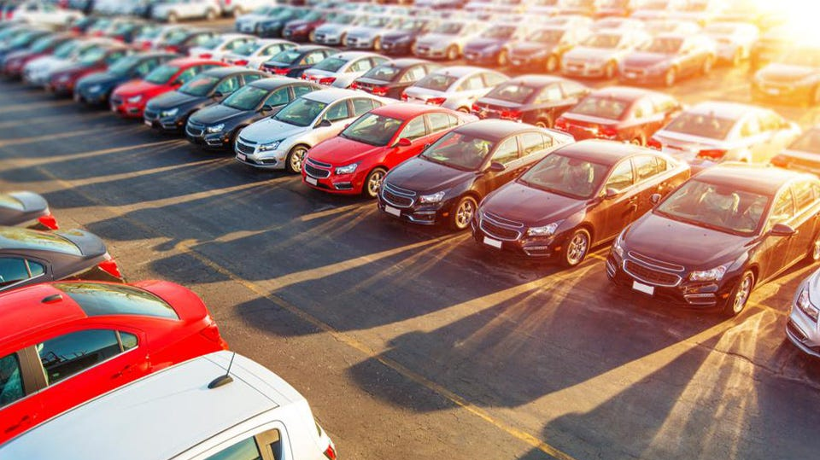
Predicting the impairment of cars
Matan Korenfeld Tair Yeruham

Slide 2

Research questions:
Can we predict the depreciation of a vehicle?
Can we predict the year of manufacture of a vehicle?

Slide 3




Stages of the project
Data Acquisition
We divided the crawl according to the car manufacturers.
Data Cleaning
EDA
We presented how is the price of the vehicle is affected.
Machine Learning
We made the withdrawal from the KOMO website.
We used beautiful soup and selenium.
We cleaned each manufacturer individually and then merged all the data frames.
We removed outliers , missing values, signs and change values to numeric.
We presented the quantities of vehicles according to the characteristics.
We presented the average of the features by manufacturer.
We built a linear regression model .
We made changes to the model, to improve its prediction.
We presented a visualization of the model prediction versus reality.

Slide 4

Data Acquisition

Slide 5
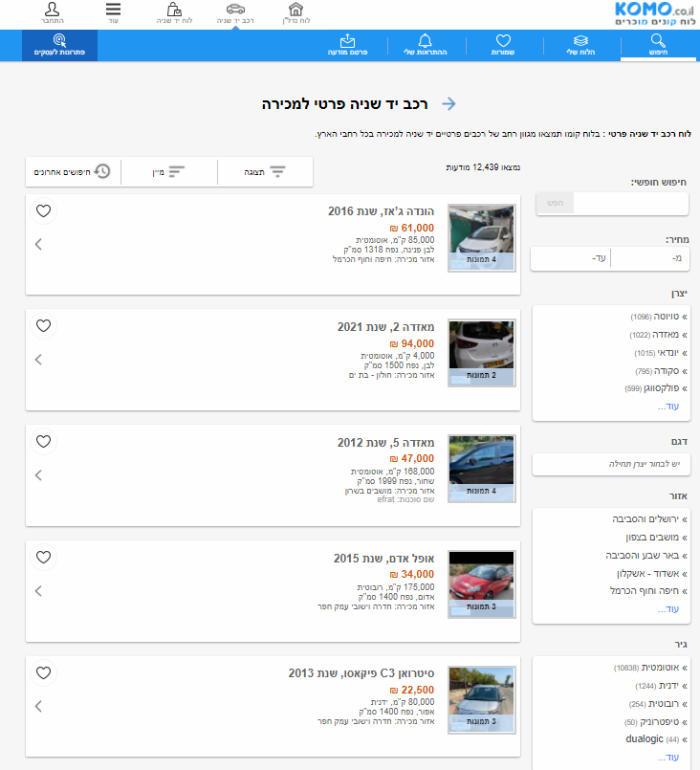
How did we acquire the information?
We used beautiful soup and selenium.
We took the data from “KOMO” website.

Slide 6
What were the difficulties ?
At first we tried to acquire information from the Yad2 website and we dealt with blockages and then we changed to the Komo website.
In order to deal with the passage of pages on the site to pull data without blockages we used selenium.
The site we used advertises 200 ads so we had to pull by manufacturer.
We learned the using of selenium and
how to use it.

Slide 7

Data Cleaning

Slide 8
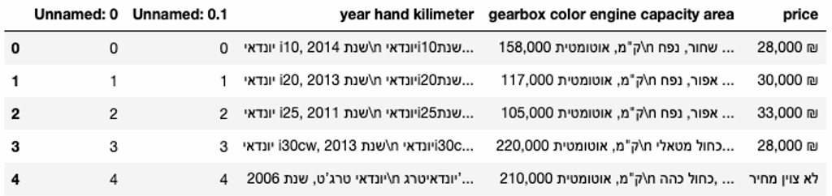
How did we handle the data?
When we withdrew the information from the site we came across columns with connected information

Slide 9
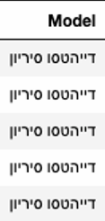
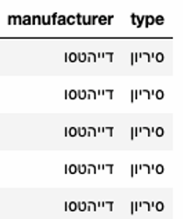
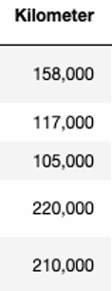
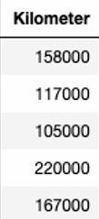
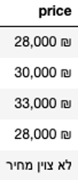
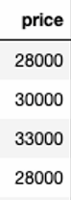
How did we handle the data?
For the model we split the column by model and manufacturer.
For the kilometer and price we deleted the missing information.
Then, we removed the comma and the NIS mark.
Finally, we converted to int.

Slide 10
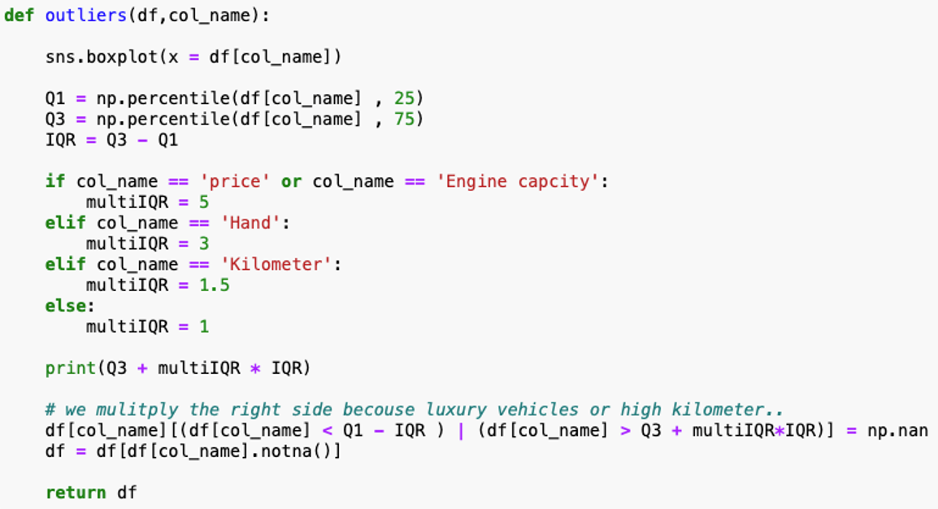
outliers
R
Q
I
For drop outliers we used IQR.

Slide 11
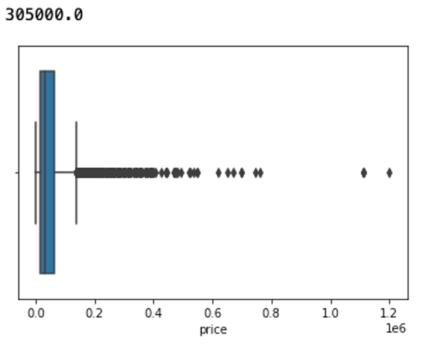
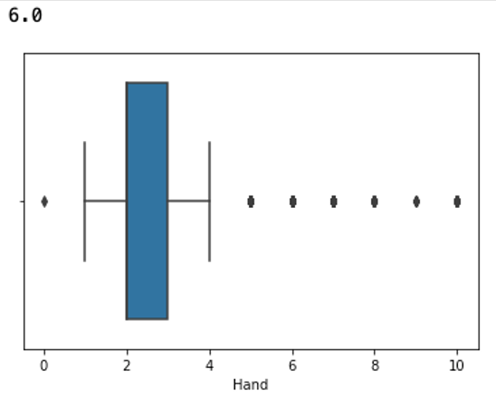
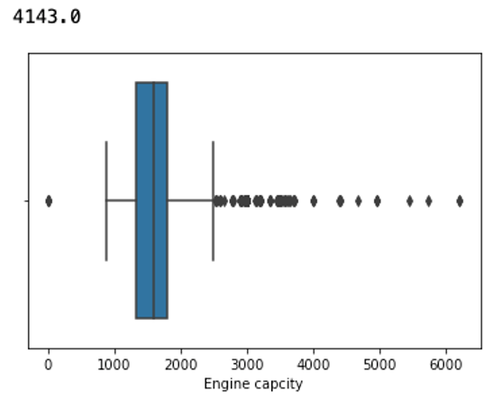
outliers
Price outliers
Hand outliers
Engine capacity outliers

Slide 12
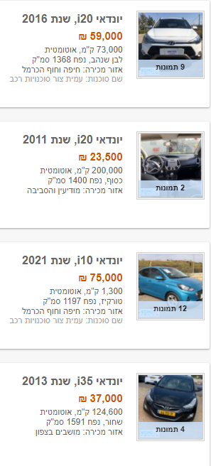
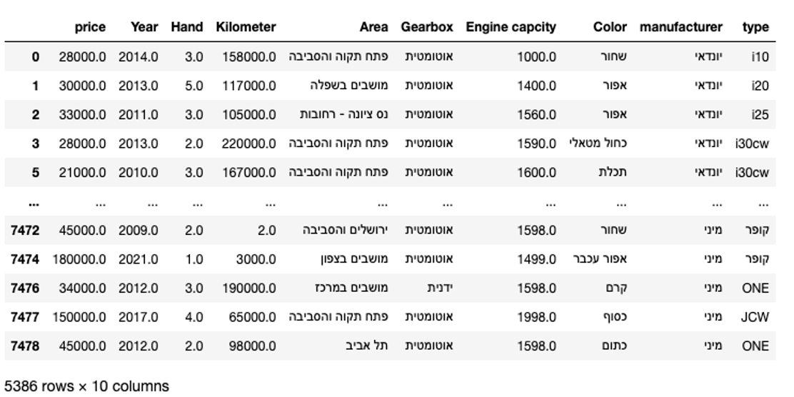
Final Data Frame

Slide 13
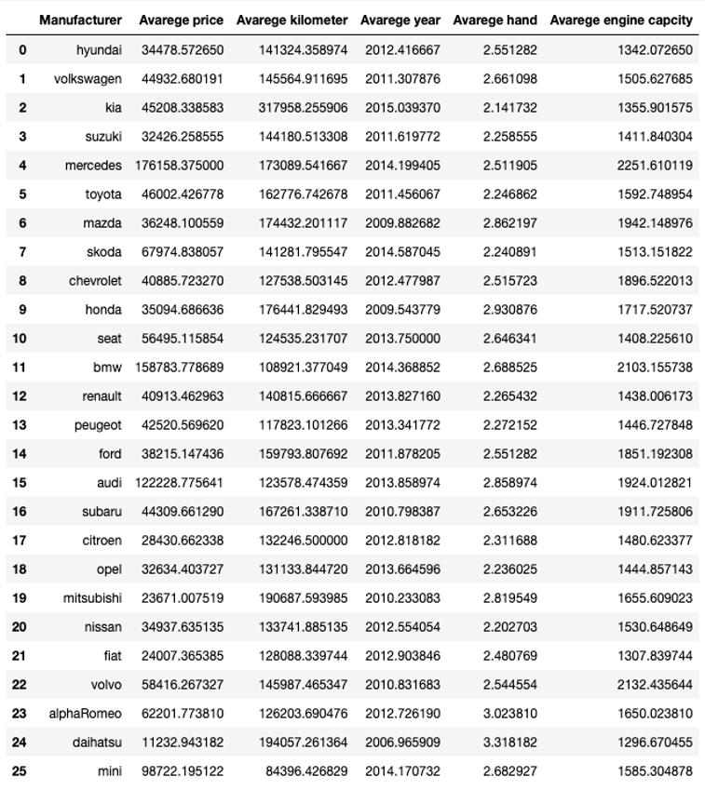
We wanted to show an average of characteristics in vehicles by manufacturer in order to make it easier for the buyer

Slide 14

EDA

Slide 15
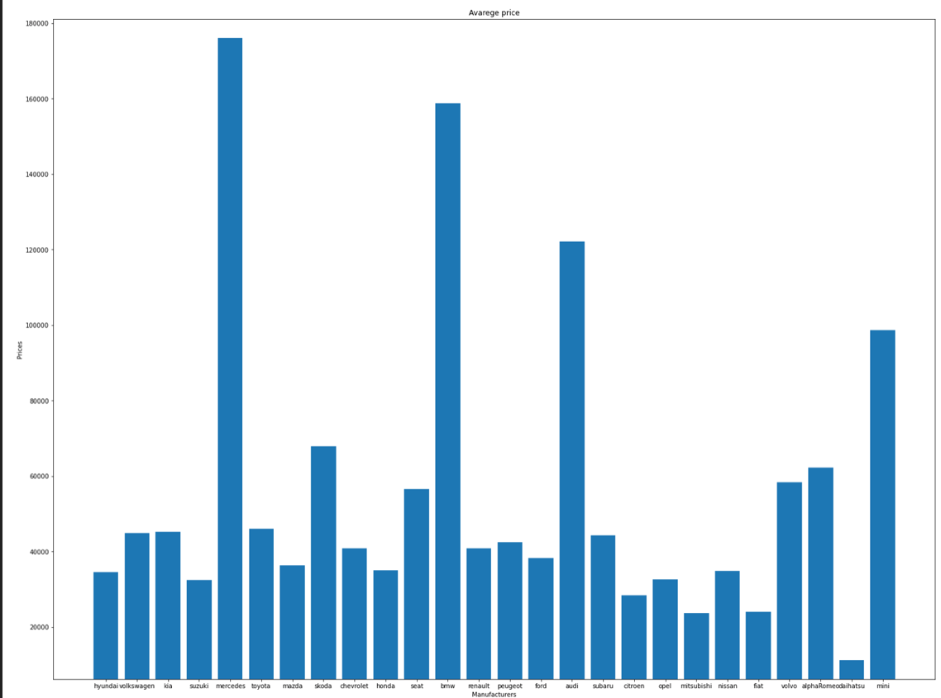
Average prices by manufacturers

Slide 16
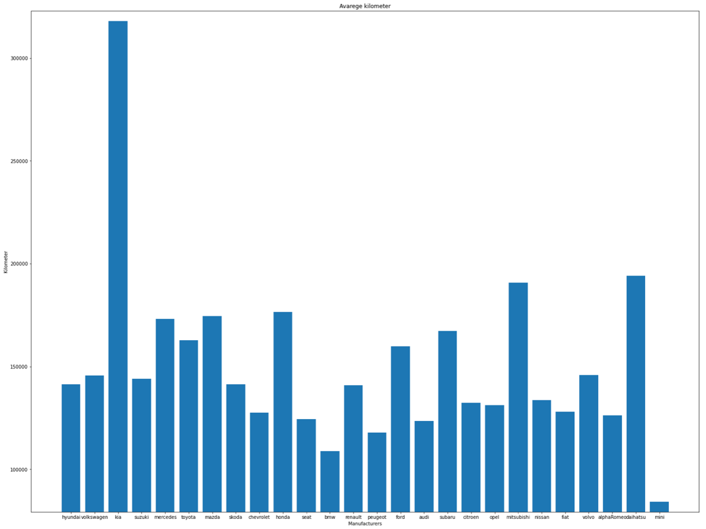
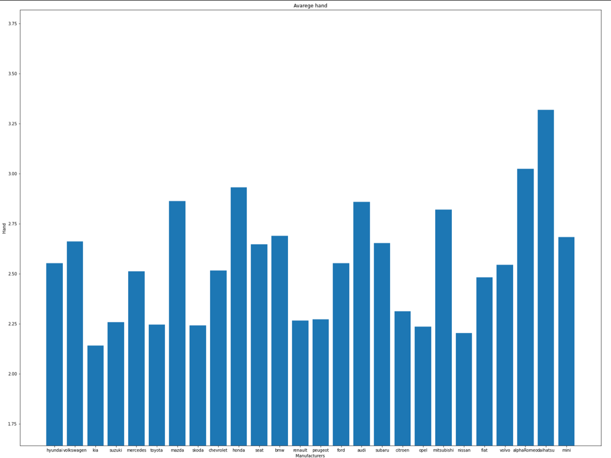
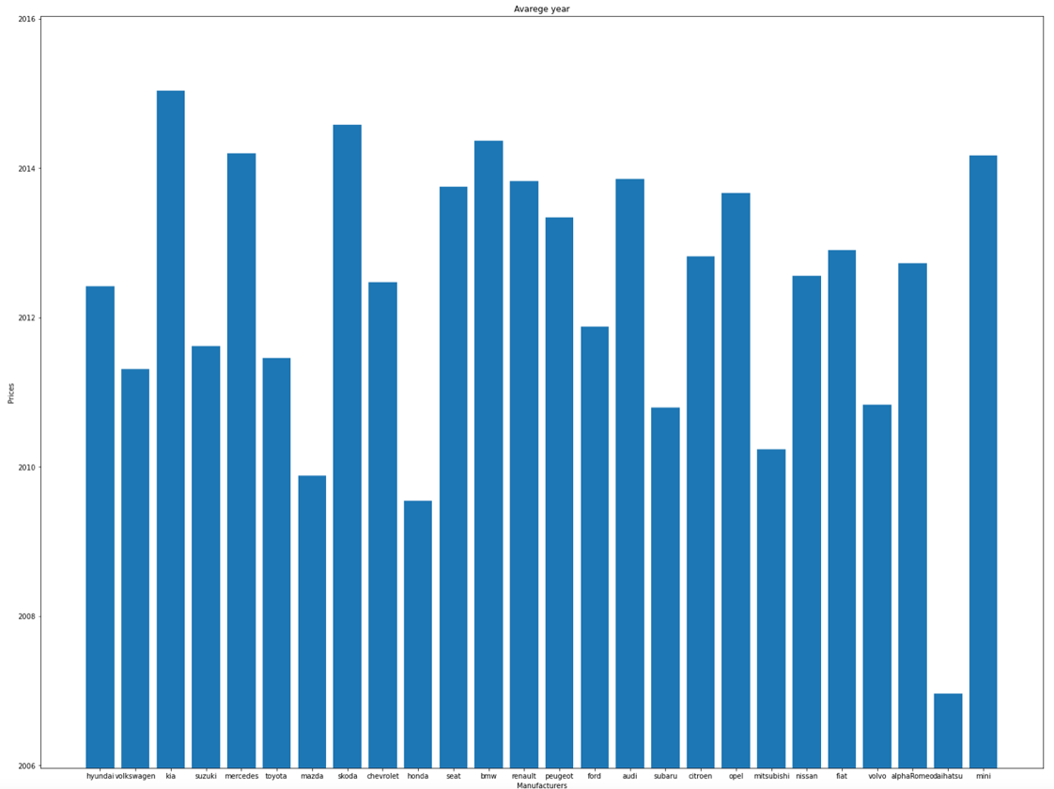
Average of cars by manufacturers
Average kilometer
Average hand
Average year

Slide 17
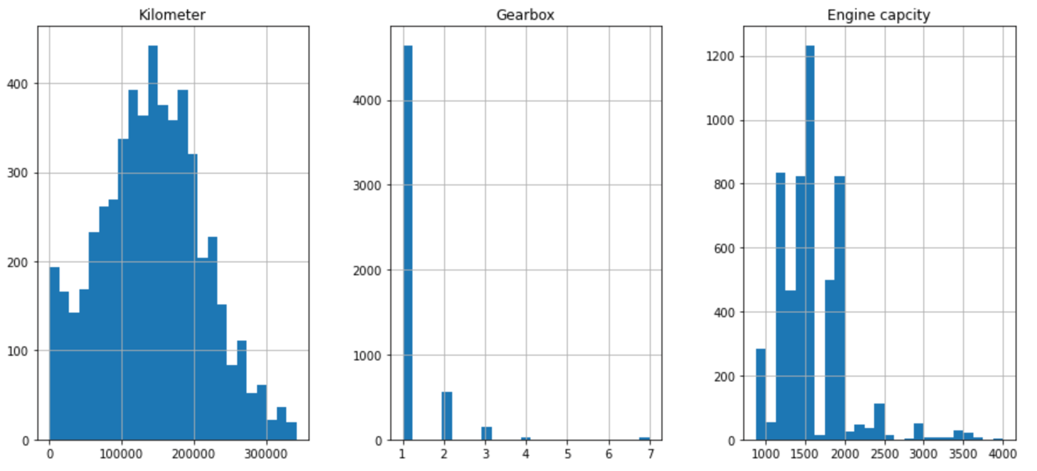
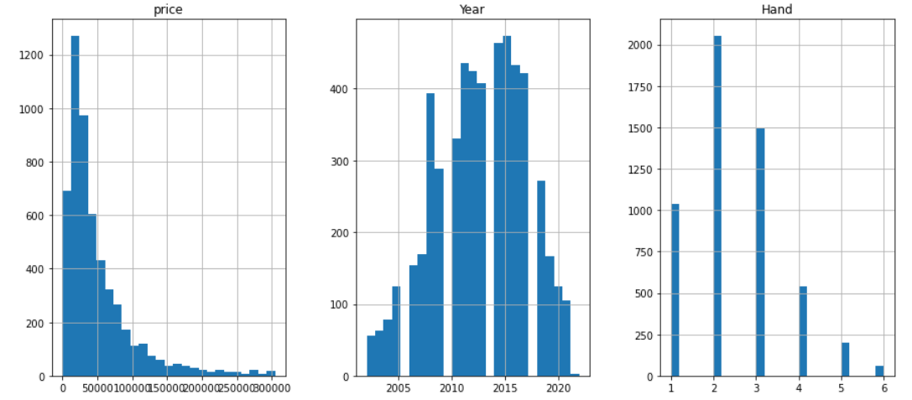
Graphical analysis of the dataset features

Slide 18
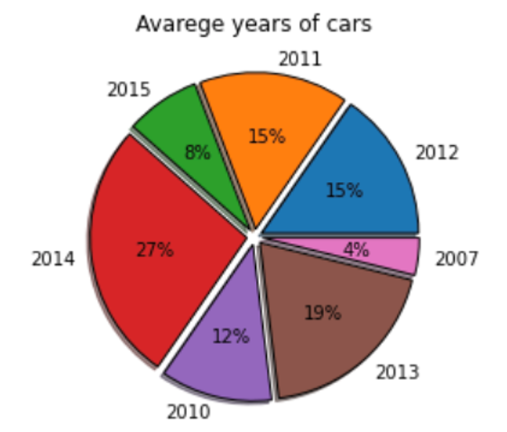
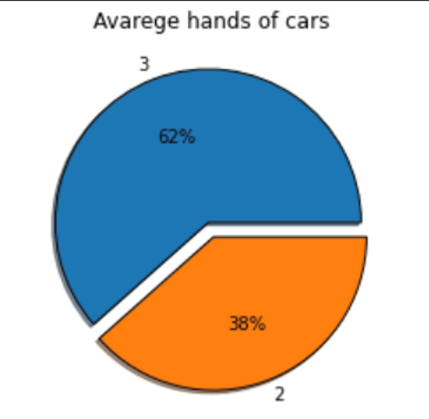
Pie chart analysis of the dataset features

Slide 19
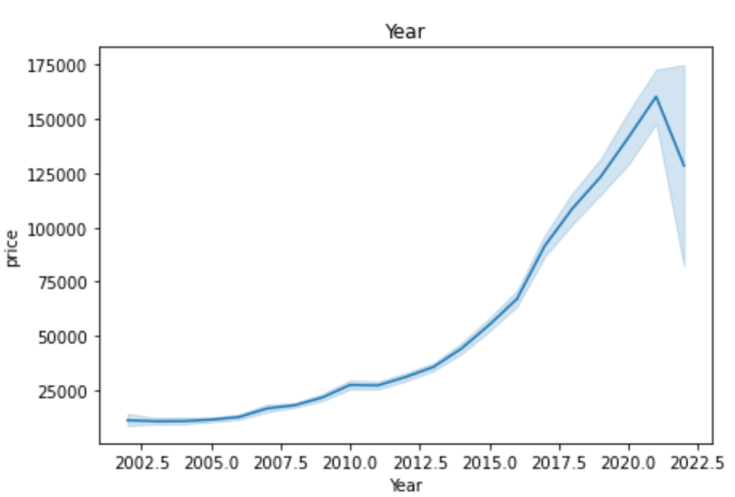

Scatter Plot which represents the rise in cars prices by the year
Wow effect
In 2021 there was a shortage of chips which led to a lack of production of new vehicles, as a result of which we discovered that there was an increase in the prices of used vehicles.

Slide 20
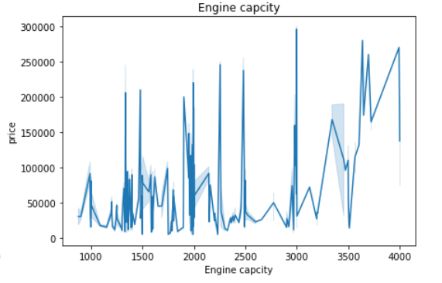
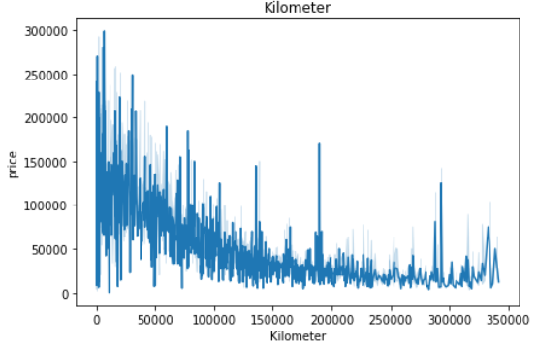
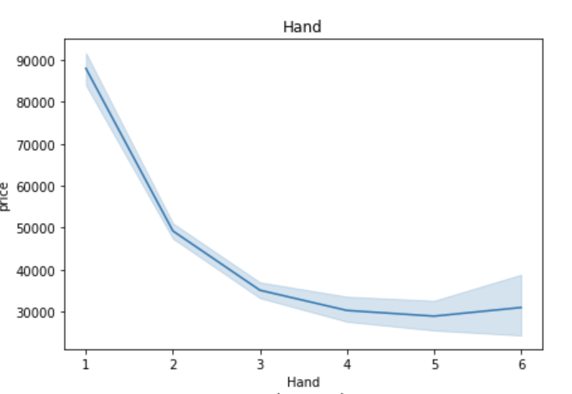
Scatter Plot which represents the rise in cars prices by the engine capacity, hand and kilometer.

Slide 21

Machine Learning

Slide 22

linear regression
For the prediction we used data we extracted from the KOMO site over 50,000 cells.
We used linear regression because we wanted to predict continuous numerical value
We built a model using linear regression, the models came out with a not so high prediction percentage of about 60% and after actions we took to improve the model we raised the prediction percentage above 70%

Slide 23
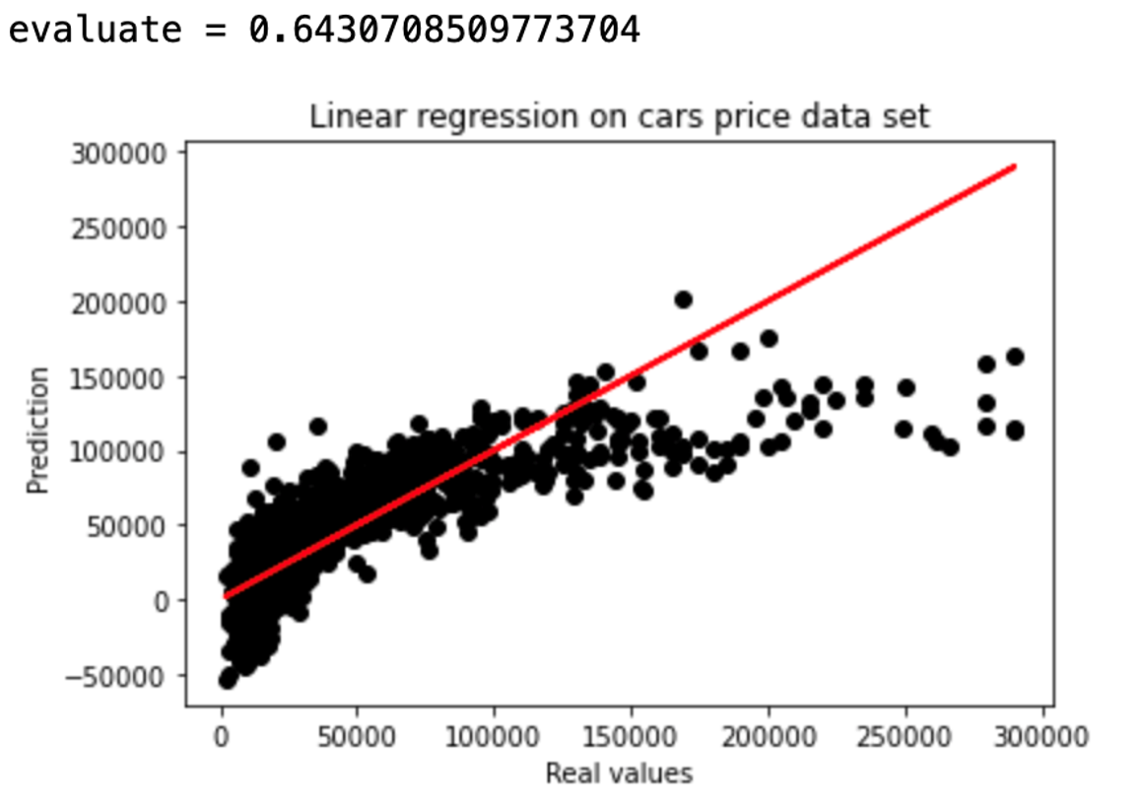
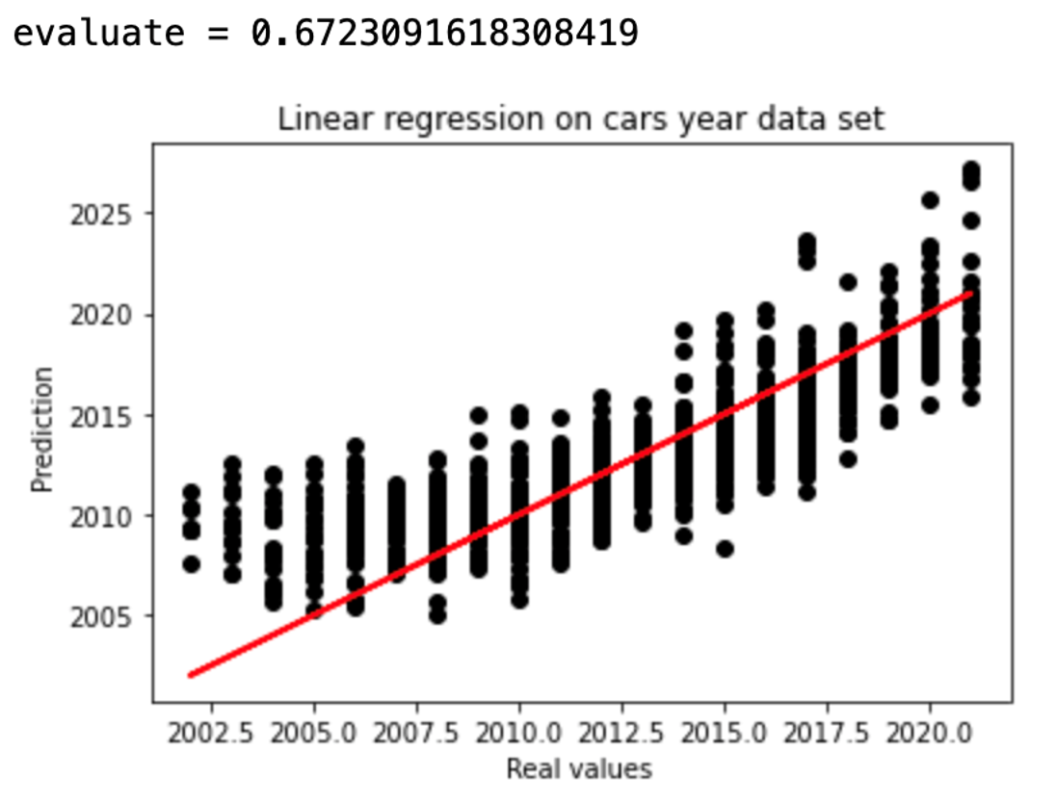
Scatter Plot that presents the model prediction of year and price against reality.

Slide 24
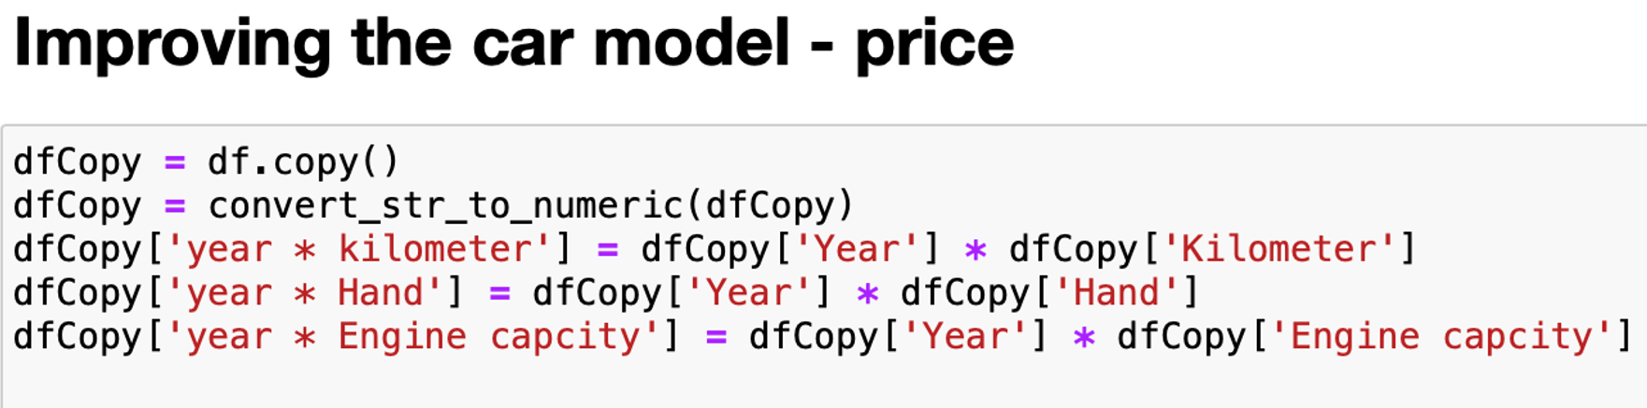
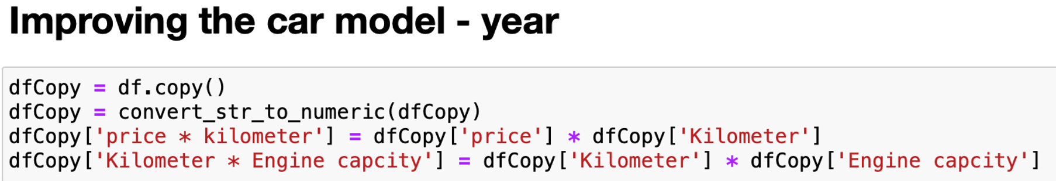

Slide 25
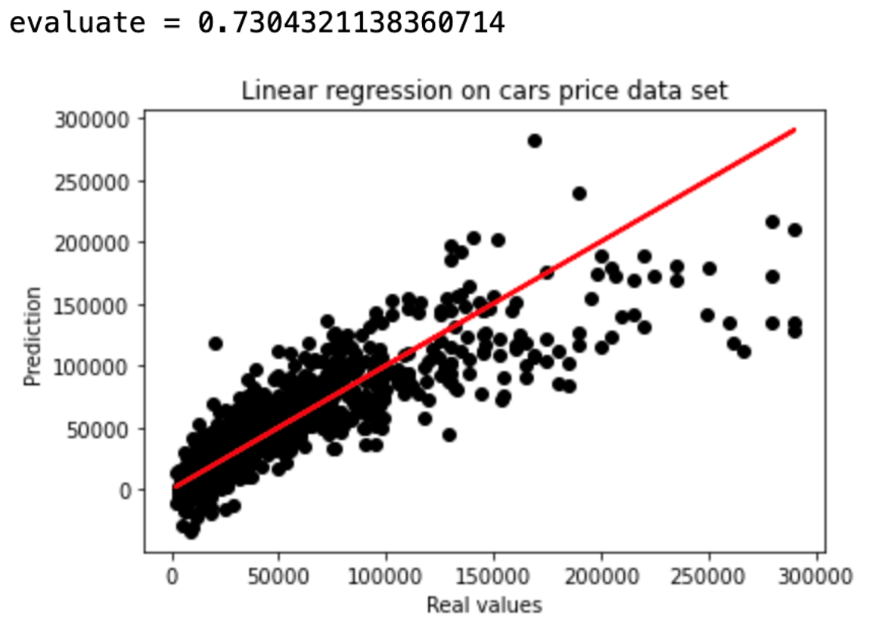
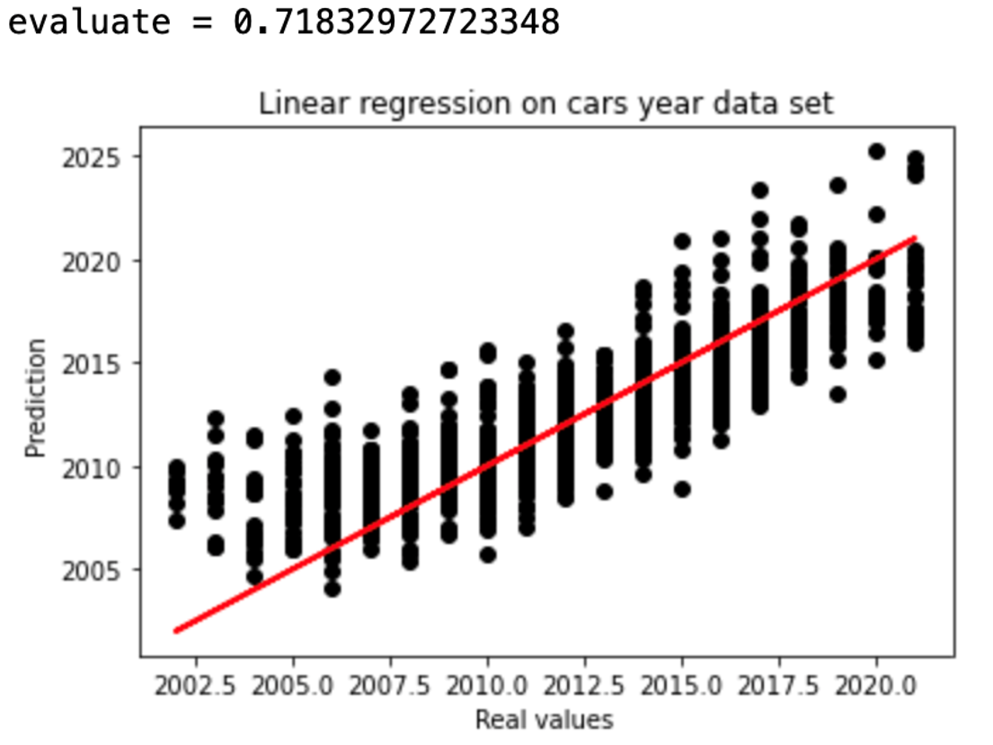
Improving the model – results

Slide 26
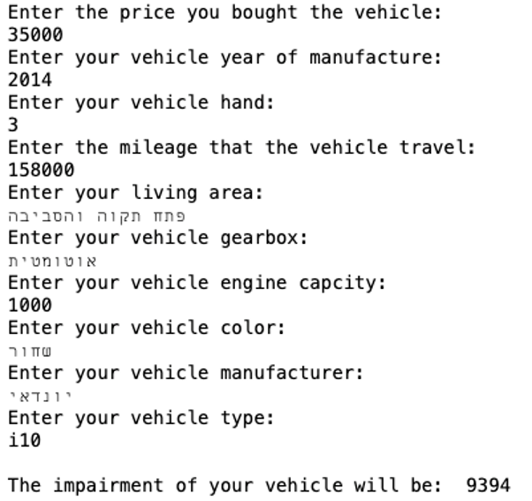
Now we will predict the depreciation of a car

Slide 27
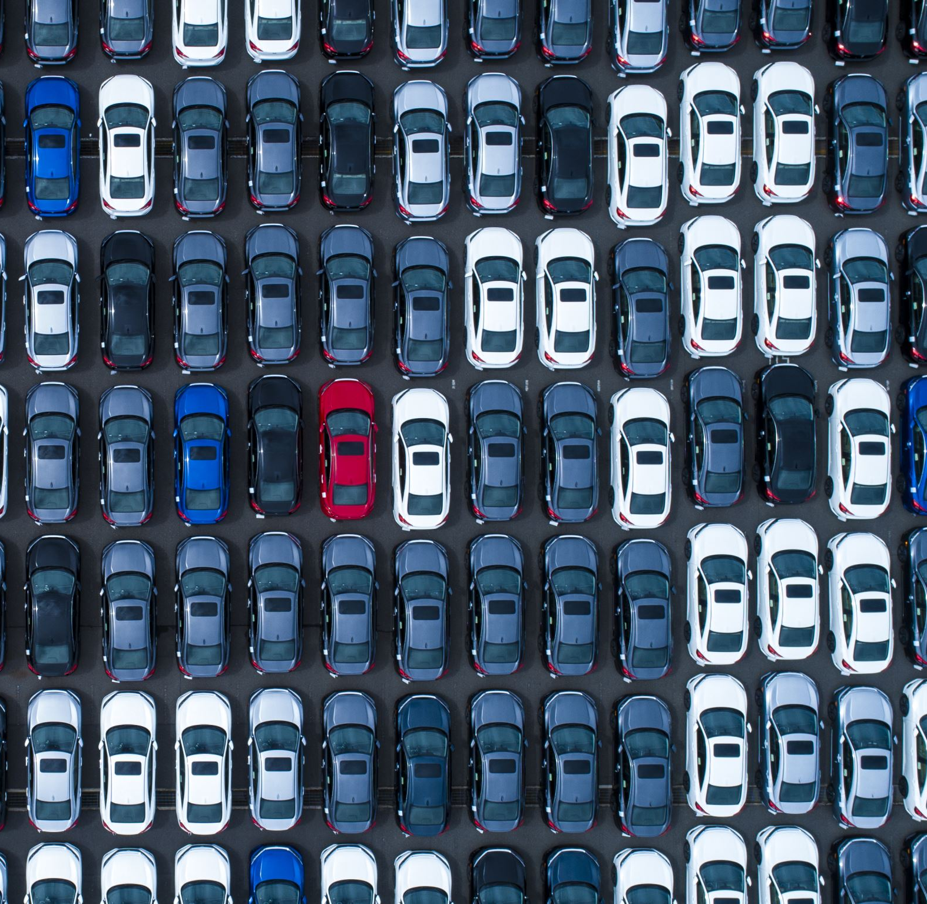

Thank you!
Tair Yeruham
Matan Korenfeld
tairyeruham@gmail.com
matankorenfeld@gmail.com
https://github.com/Tair-Yeruham/Second-hand-data-analysis

